Slide 1
Overview Design
N2PK-VNA
2) Send input commands and scan parameters
3) Output scanned data
MyVNA
1) Initiate scan and set scan parameters
AccessMyVNA
4) Export data to .csv file
Scanned data file
(myVNAdata01.csv, myVNAdata03.csv, etc.)
7) Check to see whether to continue scan
6) Update scan parameters
5) Read data file
No
Yes
QCM MATLAB Program
8) End Scan

Slide 2
Communication between AccessMyVNA and QCM MATLAB
AccessMyVNA
read
write
settings01.txt
settings03.txt
settings05.txt
settings07.txt
settings09.txt
settings11.txt
myVNAdata01.csv
myVNAdata03.csv
myVNAdata05.csv
myVNAdata07.csv
myVNAdata09.csv
myVNAdata11.csv
read
settings.txt
write
write
read
QCM MATLAB Program

Slide 3
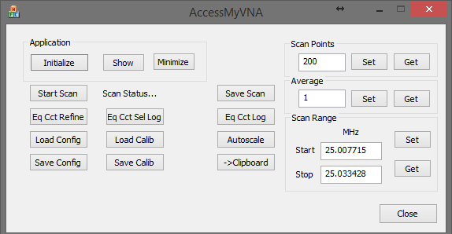

Slide 4
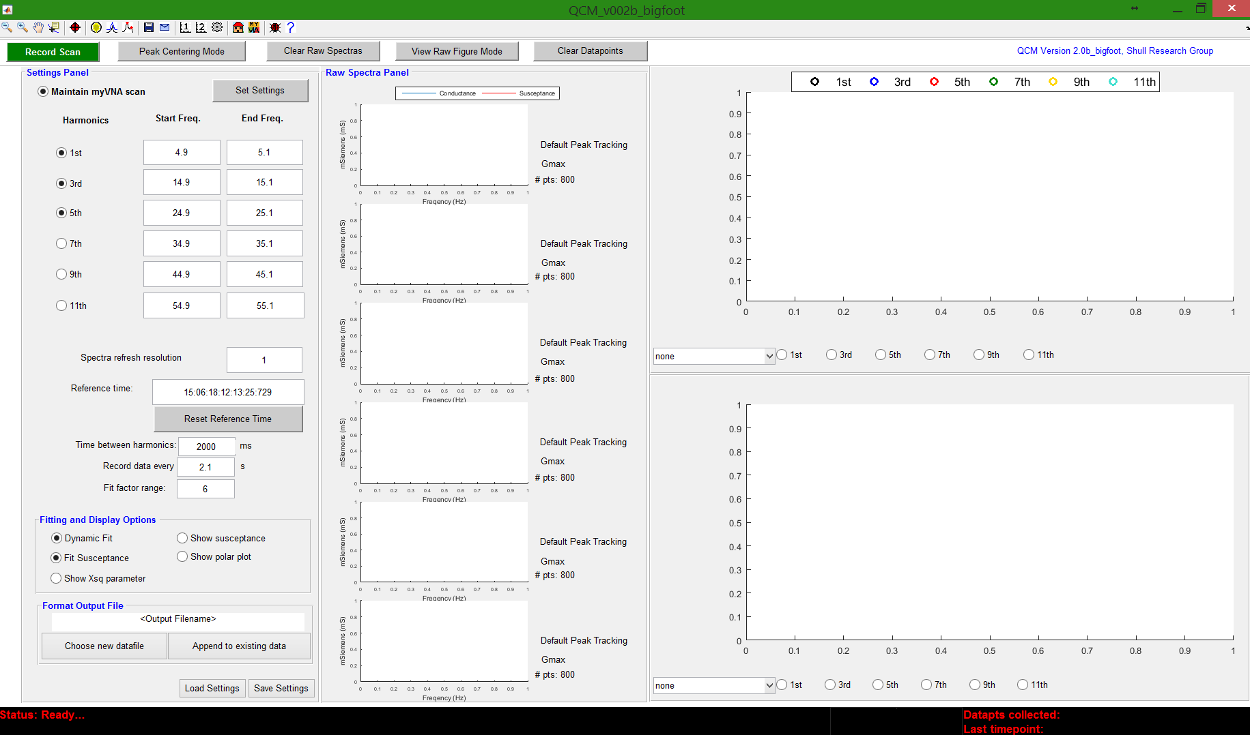
Figure toolbar
GUI toolbar
Program version
Settings panel
Raw spectra panel
Main plot panel
Status toolbar

Slide 5
2
4
6
8
10
12
14
16
1
3
5
7
9
11
13
15
2
4
6
8
10
13
15
17
1
3
5
7
9
11
12
14
16
1
2
3
4
5

Slide 6
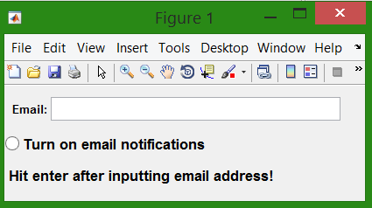
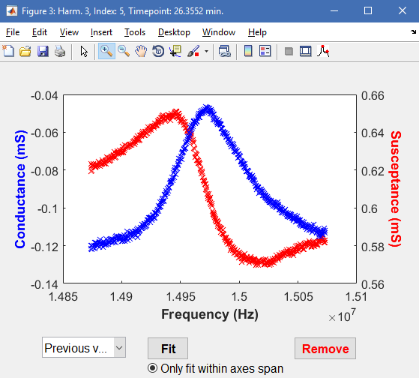

Slide 7
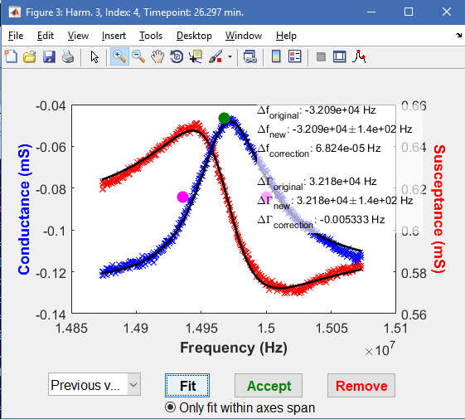

Slide 8
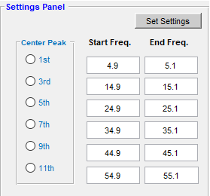
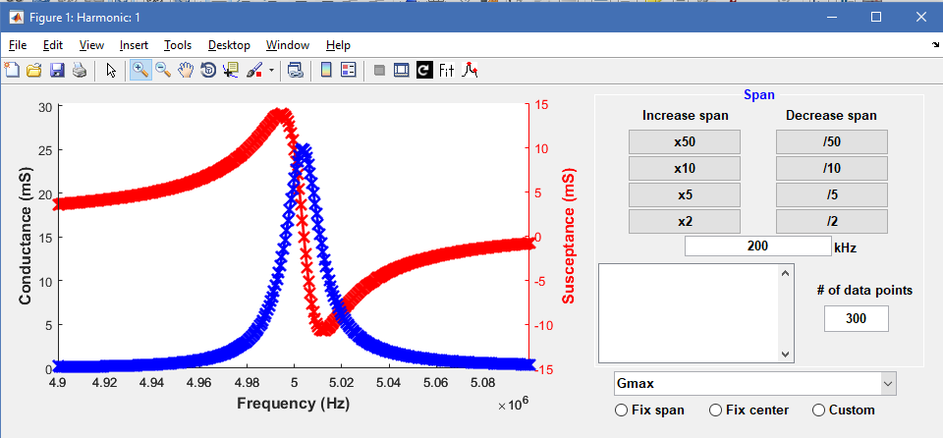

Slide 9
